Slide 1
Software Defined Networking (SDN) training
Module 1: Network Controller

Slide 2
Copyright and terms of use
Copyright and trademarks
This training package is proprietary and confidential and is intended only for uses described in the training materials. Content and software is provided to you under a Non-Disclosure Agreement and cannot be distributed. Copying or disclosing all or any portion of the content and/or software included in such packages is strictly prohibited.
The contents of this package are for informational and training purposes only and are provided "as is" without warranty of any kind, whether express or implied, including but not limited to the implied warranties of merchantability, fitness for a particular purpose, and non-infringement.
Conditions and terms of use
Training package content, including URLs and other Internet Web site references, is subject to change without notice. Because Microsoft must respond to changing market conditions, the content should not be interpreted to be a commitment on the part of Microsoft, and Microsoft cannot guarantee the accuracy of any information presented after the date of publication. Unless otherwise noted, the companies, organizations, products, domain names, e-mail addresses, logos, people, places, and events depicted herein are fictitious, and no association with any real company, organization, product, domain name, e-mail address, logo, person, place, or event is intended or should be inferred.

Slide 3
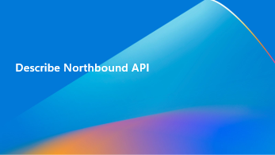
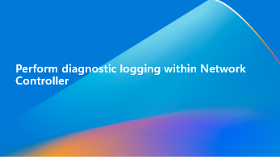
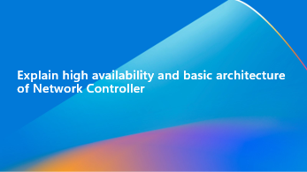
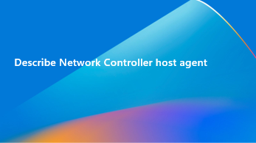
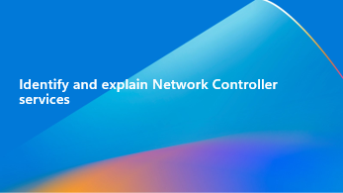
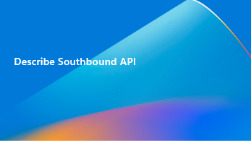
Learning objectives
By the end of this module, you will be able to:

Slide 4
Explain high availability and basic architecture of Network Controller

Slide 5
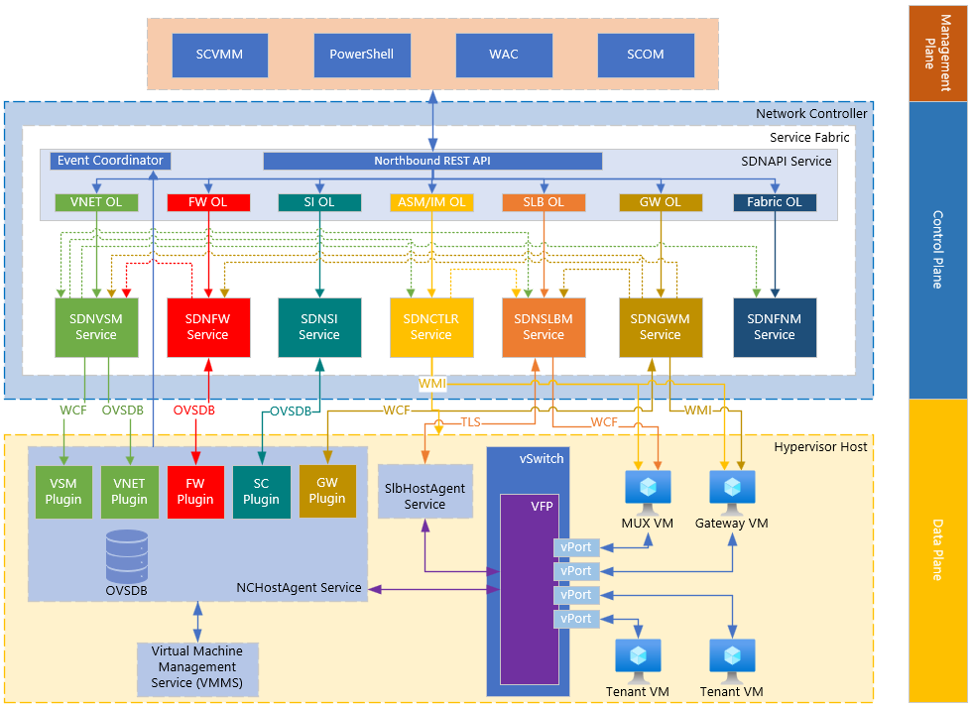
Network Controller high-level architecture
Notes:
This provides an overview of the Network Controller architecture at a high level. This module will explore the different components that make up the Network Controller architecture, with further expansion of certain topics into more focused modules.

Slide 6
Architecture overview
Highly available and scalable server role
Separates functionality into service modules (microservices)
Relies on Windows Service Fabric for high availability
Northbound API (REST interface)
Provides you with the ability to gather network information from network controller and use it to monitor and configure the network.
Configure, monitor, troubleshoot and deploy new devices on the network by using Windows PowerShell, REST, System Center Virtual Machine Manager (SCVMM), Windows Admin Center (WAC), and more.
Uses a JSON data model to represent resources.
Supports CRUD operations on resources through NB API.
Southbound API
Network controller can discover network devices, detect service configurations, and gather all the information you need about the network.
Provides pathway to send information to the network infrastructure, such as configuration changes that you have made.
Management applications
Network-aware applications
Network controller
Virtual network infrastructure
Physical network infrastructure
NIC
Notes:
Network Controller is a highly available and scalable server role and provides one application programming interface (API) that allows Network Controller to communicate with the network, and a second API that allows you to communicate with Network Controller.
You can deploy Network Controller in both domain and non-domain environments. In domain environments, Network Controller authenticates users and network devices by using Kerberos; in non-domain environments, you must deploy certificates for authentication.
Network Controller communicates with network devices, services, and components by using the Southbound API. With the Southbound API, Network Controller can discover network devices, detect service configurations, and gather all of the information you need about the network. In addition, the Southbound API gives Network Controller a pathway to send information to the network infrastructure, such as configuration changes that you have made.
The Network Controller Northbound API provides you with the ability to gather network information from Network Controller and use it to monitor and configure the network.
The Network Controller Northbound API allows you to configure, monitor, troubleshoot, and deploy new devices on the network by using Windows PowerShell, the Representational State Transfer (REST) API, or a management application with a graphical user interface, such as Azure Stack.

Slide 7
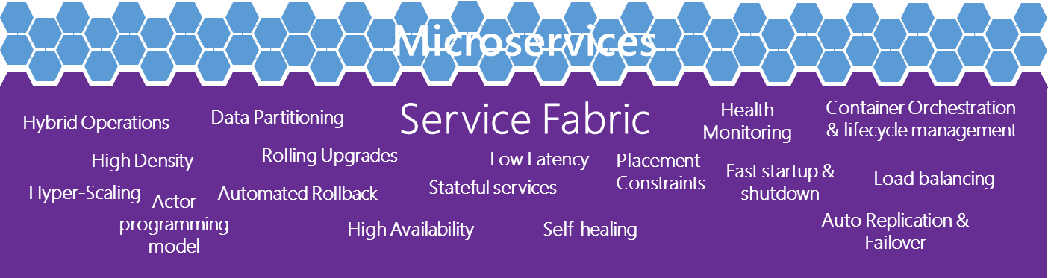
Windows Service Fabric
State Replication and Quorum Management
Failure detection
Reliable reconfiguration and leader election
Reliable and efficient data processing
Service Load Balancing
Manageability of large-scale service: alerting, patching and upgrading services
Notes:
To achieve high availability and scalability, Network Controller relies on Service Fabric. Service Fabric provides a distributed systems platform to build scalable, reliable, and easily-managed applications.
As a platform, Service Fabric provides functionality that is required for building a scalable distributed system. It provides service hosting on multiple operating system instances, synchronizing state information between instances, electing a leader, failure detection, load balancing, and more.

Slide 8
Stateful services
Each service module is represented by a service within Service Fabric
Services are leveraging Stateful service, which are modeled as set of replicas (nodes)
Each replica is running instance of code
Read/Write operations are performed against the replica that is marked as Primary
Changes to configuration state are replicated to Active Secondary replicas
Only one replica can be marked as Primary, however can have multiple Active Secondary
If primary replica goes down, Service Fabric will promote one of the Active Secondary replicas to Primary
Notes:
A stateful service has a state associated with it. In Service Fabric, a stateful service is modeled as a set of replicas. Each replica is a running instance of the code of the service. The replica also has a copy of the state for that service. Read and write operations are performed at one replica, called the Primary. Changes to state from write operations are replicated to the other replicas in the replica set, called Active Secondaries, and applied.
There can be only one Primary replica, but there can be multiple Active Secondary replicas. The number of active Secondary replicas is configurable, and a higher number of replicas can tolerate a greater number of concurrent software and hardware failures.
If the Primary replica goes down, Service Fabric makes one of the Active Secondary replicas the new Primary replica. This Active Secondary replica already has the updated version of the state, via replication, and it can continue processing further read/write operations. This process is known as reconfiguration and is described further in the Reconfiguration article.
The concept of a replica being either a Primary or Active Secondary is known as the replica role. These replicas are described further in the Replicas and instances article.
Availability of Service Fabric services - Azure Service Fabric | Microsoft Learn

Slide 9
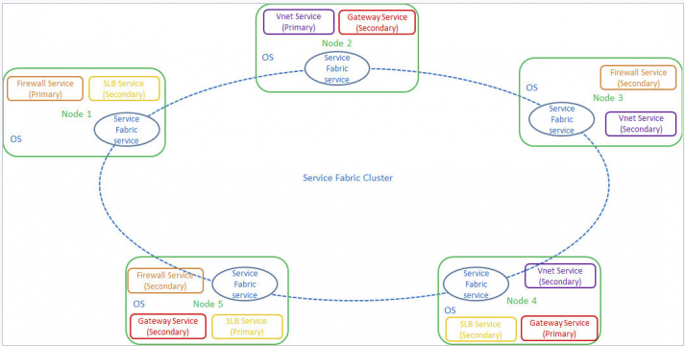
Network Controller Service Fabric services
Notes:
When you deploy Network Controller on multiple machines, Network Controller runs as a single Service Fabric application on a Service Fabric cluster. You can form a Service Fabric cluster by connecting a set of operating system instances. The Network Controller application is comprised of multiple stateful Service Fabric services. Each service is responsible for a network function, such as physical network management, virtual network management, firewall management, or gateway management.
Each Service Fabric service has one primary replica and multiple secondary replicas. The primary service replica processes requests, while the secondary service replicas provide high availability in circumstances where the primary replica is disabled or unavailable for some reason.

Slide 10
Availability of Service Fabric Stateful services
Network Controller Node 1
Fault Domain 1
Stateful Microservice
Secondary
Stateful Microservice
Secondary
Network Controller Node 2 Fault Domain 2
Network Controller Node 3 Fault Domain 3
Stateful Microservice
Primary
Service
Fabric
Cluster
Notes:
If most of the replicas for a stateful service's partition go down, that partition will enter a state known as quorum loss. At this point, Service Fabric will stop allowing writes to that partition to ensure that its state remains consistent and reliable.

Slide 11
Availability of Service Fabric Stateful services
Network Controller Node 1 Fault Domain 1
Stateful Microservice
Primary
Stateful Microservice
Secondary
Network Controller Node 2 Down
Fault Domain 2
Network Controller Node 3 Fault Domain 3
Service
Fabric
Cluster
Quorum OK
Notes:
Individual machine failures (either within the VM or in the hardware or software hosting it within a fault domain) pose no risk on their own. Service Fabric will typically detect the failure within seconds and respond accordingly based on the state of the cluster. For instance, if the node was hosting the primary replicas for a partition, a new primary will be elected from the partition's secondary replicas. When a failed machine is back online, it will rejoin the cluster automatically and once again take on its share of the workload.

Slide 12
Availability of Service Fabric Stateful services
Network Controller Node 1
Fault Domain 1
Network Controller Node 3 Down
Fault Domain 3
Stateful Microservice
Read Only Mode
Network Controller Node 2 Down
Fault Domain 2
Service
Fabric
Cluster
Quorum Loss
TargetReplicaSetSize=3
Notes:
MinReplicaSetSize of 3 is the smallest number recommended for production services. With a TargetReplicaSetSize of 3 (one primary and two ActiveSecondary), a hardware failure during an upgrade (two replicas down) will result in quorum loss and your service will become read-only.

Slide 13
Stateless services
Does not require highly available or reliable service.
When instance of stateless named-service fails, new instance is created within the cluster.
Notes:
Service Fabric services can be either stateful or stateless. A stateless service is an application service that does not have a local state that needs to be highly available or reliable.
Creating a stateless service requires defining an InstanceCount. The instance count defines the number of instances of the stateless service's application logic that should be running in the cluster. Increasing the number of instances is the recommended way of scaling out a stateless service.
When an instance of a stateless named-service fails, a new instance is created on an eligible node in the cluster. For example, a stateless service instance might fail on Node1 and be re-created on Node5.

Slide 14
Cluster authentication
Network Controller nodes communicate with each other using WCF and TCP.
Cluster Authentication can be set to Kerberos, X509, or None.
Authentication type | Requirements
Kerberos | Nodes must be domain joined
X509 | Nodes do not need to be domain joined Subject Name must match DNS name of node Cert must be trusted on each of the NC nodes
None | Used for test purposes only No authentication performed
Notes:
Network Controller supports authentication, authorization, and encryption for communication between Network Controller nodes. The communication is over Windows Communication Foundation (WCF) and TCP.
You can configure this mode with the ClusterAuthentication parameter of the Install-NetworkControllerCluster Windows PowerShell command.
When you configure authentication for Network Controller Cluster communication, you allow Network Controller cluster nodes to verify the identity of the other nodes with which they are communicating.
Network Controller supports the following three modes of authentication between Network Controller nodes.
Note
If you deploy Network Controller by using SCVMM, only Kerberos mode is supported.
Kerberos. You can use Kerberos authentication when all Network Controller cluster nodes are joined to an Active Directory domain, with domain accounts used for authentication.
X509. X509 is certificate-based authentication. You can use X509 authentication when Network Controller cluster nodes are not joined to an Active Directory domain. To use X509, you must enroll certificates to all Network Controller cluster nodes, and all nodes must trust the certificates. In addition, the subject name of the certificate that is enrolled on each node must be the same as the DNS name of the node.
None. When you choose this mode, there is no authentication performed between Network Controller nodes. This mode is provided only for testing purposes and is not recommended for use in a production environment.
Network Controller Security - Azure Stack HCI | Microsoft Learn

Slide 15
Cluster authorization
Ensures that the NC cluster nodes are communicating with trusted nodes
Accounts are added when adding new network controller node into the cluster
Authentication type | Details
Kerberos | Accept communication requestions only from other Network Controller machine accounts. Accounts leverage the Name parameter defined during deployment.
X509 | Authorization is based on subject name or thumbprint of the certificate of the caller Subject name or thumbprint must match what is configured for network controller cluster
None | No authorization performed. For testing purposes only and not recommended for production.
Notes:
When you configure authorization for Network Controller Cluster communication, you allow Network Controller cluster nodes to verify that the nodes with which they are communicating are trusted and have permission to participate in the communication.
For each of the authentication modes supported by Network Controller, the following authorization methods are used.
Kerberos. Network Controller nodes accept communication requests only from other Network Controller machine accounts. You can configure these accounts when you deploy Network Controller by using the Name parameter of the New-NetworkControllerNodeObject Windows PowerShell command.
X509.
None. When you choose this mode, there is no authorization performed between Network Controller nodes. This mode is provided only for testing purposes, and is not recommended for use in a production environment.
Network Controller Security - Azure Stack HCI | Microsoft Learn

Slide 16
Cluster encryption
Cluster traffic between nodes is encrypted using WCF transport level encryption
Supports either X509 or Kerberos for authentication and authorization
More information on WCF encryption can be found at:
https://learn.microsoft.com/en-us/dotnet/framework/wcf/how-to-secure-a-service-with-windows-credentials
https://learn.microsoft.com/en-us/dotnet/framework/wcf/feature-details/how-to-secure-a-service-with-an-x-509-certificate
Notes:
Communication between Network Controller nodes is encrypted using WCF Transport level encryption. This form of encryption is used when the authentication and authorization methods are either Kerberos or X509 certificates. For more information, see the following topics.
How to: Secure a Service with Windows Credentials
How to: Secure a Service with X.509 Certificates.

Slide 17

Lab
Examine Service Fabric
Disable and Enable Service Fabric Node
Examine an Unhealthy Cluster
Examine Cluster Authentication

Slide 18
Knowledge check – Network Controller architecture
What is the role of Windows Service Fabric in Network Controller?
What are the two types of Services within Service Fabric?
Notes:
See answers at end of the deck.

Slide 19
Describe Northbound API

Slide 20
Northbound API overview
Network Controller control plane capabilities are exposed up to management applications (such as SCVMM, WAC, WAP/NRP, and SCOM) through a NorthBound interface (NBI).
The NBI is a RESTful API using JSON as the message format.
NBI is its own service (SDNAPI.exe) in the network controller cluster
SDNAPI provides orchestration across the other services
NBI provides unified view of services
Operations against NBI are orchestrated across one or many services
Management applications
Network-aware applications
Northbound API
Network controller
Notes:
Network Controller control plane capabilities are exposed up to management applications (such as SCVMM, WAC, WAP/NRP, and SCOM) through a NorthBound interface (NBI).
The NBI is a RESTful API using JSON as the message format. The NBI will be its own service (SDNAPI.exe) in the network controller cluster, and in addition to providing the web server exposing the REST interfaces, it will provide a level of orchestration across the various services that comprise the network controller.
This orchestration will provide the user of the NBI a unified view of the services provided by the network controller and allow them to make single API calls into the NBI that touch multiple services, even when there needs to be explicit ordering between the services.

Slide 21
Northbound API
Secured via HTTPS (TLS) with X.509 certificates
Defines a hierarchical URI scheme for defining resources
https://<NC URL>/networking/<api version>/<parent resource>/<parent resourceId>/<child resource>/<child resourceId>
RESTful using HTTP verbs GET, PUT, and DELETE
Create (PUT), Read (GET), Update (PUT), Delete (DELETE)
Create new resources through an HTTP PUT to the resource URI (with unique resourceId) with JSON in request body
Read existing resources through an HTTP GET of a URI: Returns JSON
Update existing resources through an HTTP PUT to the resource URI with updated JSON in request body
Delete existing resources with an HTTP DELETE of the resource’s URI
Notes:
For more information, go to: [MS-NCNBI]: Network Controller Northbound Interface | Microsoft Learn

Slide 22
Northbound API endpoint
Can leverage dynamic DNS or Static IP for endpoint.
FQDN will match the x509 certificate subject.
Deployment Type | Details
Dynamic DNS Registration | Api Service will dynamically register NB API FQDN in DNS during replica failover. Requires appropriate permissions within DNS infrastructure for dynamic registration. HCI - Dynamic DNS updates
Static IP | Operator must manually configure static IP address in their DNS. During failover, ApiService will program secondary IP address on adapter. IP Address must be within same subnet as Network Controller VMs.
Notes:
During deployment, you can specify if using RestName or RestIPAddress which will determine how the NC Northbound API endpoint will be registered into your DNS for name resolution. To determine what you have configured, leverage Get-NetworkController on your Network Controller. Dynamic If within Get-NetworkController you have the RestName populated, you are going to leverage Dynamic DNS. When deploying and leveraging Dynamic DNS, you need to ensure that the instructions in https://learn.microsoft.com/en-us/azure-stack/hci/concepts/network-controller#dynamic-dns-updates have been followed.
When the ApiService primary replica moves between Network Controller nodes, it will perform a DNS Query for the FQDN of the RestName. If the IP address returned from DNS does not match the IP address of the interfaces of the NC primary replica, it will proceed with:
Send DNS UPDATE to DELETE the current record.
Send DNS UPDATE to CREATE a new record with the IP Address
Static
If within Get-NetworkController you have the RestIPAddress populated, you are going to leverage a Static IP address. This is beneficial depending on DNS configuration or if not leveraging Windows AD-Integrated DNS. In this scenario when the ApiService primary replica moves to a new Network Controller, it will program a secondary IP address on the interface.

Slide 23
Common JSON elements
ResourceId: User-defined ID which is unique in the context of the top-level resource or direct parent of child resource.
ResourceRef: A relative URI to an associated resource.
InstanceId (Read Only): Globally unique ID generated by the network controller.
Tags: Key-value pairs of arbitrary data that the client stores with the resource on the controller.
ResourceMetadata: Structured data that the client provides to the server. This is an optional element, but it is suggested that all clients fill in the data that is applicable to them.
ProvisioningState (Read Only): A resource’s state in the network controller: Succeeded, Failed, Updating, Deleting.
Properties: Array of structured data. The structure of this data is unique to each resource except two common read-only elements - etag and provisioningState.
Notes:
Every resource that supports CRUD operations uses common JSON elements in any request or response.

Slide 24
JSON collections
accesscontrollists | loadbalancermuxes | publicipaddresses
auditingsettings | logicalnetworks | routetables
credentials | macpools | securitytags
diagnostics | multisite | servers
discovery | multisiteprimary | serviceinsertions
gateways | networkcontrollerbackup | subnetegressreset
idnsserver | networkcontrollerrestore | virtualgateways
internalresourceinstances | networkcontrollerstatistics | virtualnetworkmanager
learnedipaddresses | networkinterfaces | virtualnetworks
loadbalancers | operations | virtualservers
loadbalancermanager | operationresults | virtualswitchmanager
Notes:
There are extensive resources that are managed by Network Controller. To see full details regarding each resource, refer to [MS-NCNBI]: Message Processing Events and Sequencing Rules | Microsoft Learn which will provide extensive details on each of the available properties, operations allowed as well as the version of NC application that is required.

Slide 25
Northbound authentication
Authentication type | Requirements
Kerberos | Management client and nodes must be domain joined
X509 | Management client and nodes do not need to be domain joined Must enroll certificates to all NC cluster nodes and management clients Must trust each others’ certificates
None | Used for test purposes only No authentication performed
Notes:
When you configure authentication for Network Controller Northbound communication, you allow Network Controller cluster nodes and management clients to verify the identity of the device with which they are communicating. Network Controller supports the following three modes of authentication between management clients and Network Controller nodes.
Note: If you are deploying Network Controller with System Center Virtual Machine Manager, only Kerberos mode is supported.
Kerberos. Use Kerberos authentication when joining both the management client and all Network Controller cluster nodes to an Active Directory domain. The Active Directory domain must have domain accounts used for authentication.
X509. Use X509 for certificate-based authentication for management clients not joined to an Active Directory domain. You must enroll certificates to all Network Controller cluster nodes and management clients. Also, all nodes and management clients must trust each others' certificates.
None. Use None for testing purposes in a test environment and, therefore, not recommended for use in a production environment. When you choose this mode, there is no authentication performed between nodes and management clients.
You can configure the Authentication mode for Northbound communication by using the Windows PowerShell command Install-NetworkController with the ClientAuthentication parameter.

Slide 26
Northbound authorization
Authentication type | Requirements
Kerberos | Allows to add users and computers to security group in AD Configure NC to use security group by configuring ClientSecurityGroup Defined during Install-NetworkController operation Can be changed with Set-NetworkController
X509 | Accepts only requests from management clients with cert thumbprints trusted by Network Controller Defined using the ClientCertificateThumbprint Defined during Install-NetworkController operation Can be changed with Set-NetworkController
None | Used for test purposes only No authentication performed
Notes:
When you configure authorization for Network Controller Northbound communication, you allow Network Controller cluster nodes and management clients to verify that the device with which they are communicating is trusted and has permission to participate in the communication.
Use the following authorization methods for each of the authentication modes supported by Network Controller.
Kerberos. When you are using the Kerberos authentication method, you define the users and computers authorized to communicate with Network Controller by creating a security group in Active Directory, and then adding the authorized users and computers to the group. You can configure Network Controller to use the security group for authorization by using the ClientSecurityGroup parameter of the Install-NetworkController Windows PowerShell command. After installing the Network Controller, you can change the security group by using the Set-NetworkController command with the parameter -ClientSecurityGroup. If using SCVMM, you must provide the security group as a parameter during deployment.
X509. When you are using the X509 authentication method, Network Controller only accepts requests from management clients whose certificate thumbprints are known to Network Controller. You can configure these thumbprints by using the ClientCertificateThumbprint parameter of the Install-NetworkController Windows PowerShell command. You can add other client thumbprints at any time by using the Set-NetworkController command.
None. When you choose this mode, there is no authentication performed between nodes and management clients. Use None for testing purposes in a test environment and, therefore, not recommended for use in a production environment.

Slide 27
Northbound encryption
Uses SSL to create encrypted channel between management clients and network controller nodes
All NC nodes must have identical certificates that include Server Authentication and Client Authentication purposes in Enhanced Key Usage (EKU) extensions
URI used by management clients must be the certificate subject name. Must be either FQDN or IP address
If NC is different subnets, subject name must be the same value used for RestName
All management clients must trust the SSL certificate
Notes:
Northbound communication uses Secure Sockets Layer (SSL) to create an encrypted channel between management clients and Network Controller nodes. SSL encryption for Northbound communication includes the following requirements:
All Network Controller nodes must have an identical certificate that includes the Server Authentication and Client Authentication purposes in Enhanced Key Usage (EKU) extensions.
The URI used by management clients to communicate with Network Controller must be the certificate subject name. The certificate subject name must contain either the Fully Qualified Domain Name (FQDN) or the IP address of the Network Controller REST Endpoint.
If Network Controller nodes are on different subnets, the subject name of their certificates must be the same as the value used for the RestName parameter in the Install-NetworkController Windows PowerShell command.
All of the management clients must trust the SSL certificate.

Slide 28
Lab
Determine the Northbound API URI
Examine SDN Fabric Resources

Slide 29
Knowledge check – Northbound API
What type of authorization methods are available for securing the Northbound API?
What type of data structure does the Northbound API use?
Notes:
See answers at end of the deck.

Slide 30
Describe Southbound API

Slide 31
Southbound API overview
Network Controller communicates with network devices, services, and components by using the Southbound API.
Network Controller interacts with different types of devices, which leverage different protocols.
Learning via Southbound API is handled by Event Coordinator (EC) and delivered to appropriate service modules.
Network controller
Southbound API
Virtual network infrastructure
Physical network infrastructure
NIC
Notes:
Network Controller communicates with network devices, services, and components by using the Southbound API. With the Southbound API, Network Controller can discover network devices, detect service configurations, and gather all of the information you need about the network. In addition, the Southbound API gives Network Controller a pathway to send information to the network infrastructure, such as configuration changes that you have made.

Slide 32
Southbound communication
Southbound Device / Service | Protocol | Authentication Used
Software Load Balancer (SLB) | WCF (MUX), TCP (Host) | Certificates
Firewall | OVSDB | Certificates
Gateway | WinRM | Kerberos, Certificates
Virtual Networking | OVSDB, WCF | Certificates
User defined routing | OVSDB | Certificates
Notes:
Network Controller interacts with different types of devices for Southbound communication. These interactions use different protocols. Because of this, there are different requirements for authentication, authorization, and encryption depending on the type of device and protocol used by Network Controller to communicate with the device.
The following table provides information about Network Controller interaction with different southbound devices.
For each of these protocols, the communication mechanism is described in the following section.

Slide 33
Southbound authentication
Protocol | Description
WCF / TCP / OVSDB | Authentication is performed using X509 certificates Both NC and SB device must present their certificates for mutual authentication Each certificate must be trusted by remote peer
WinRM | Kerberos is used for domain joined machines X509 certificates used for non-domain joined machines

Slide 34
Southbound authorization
Protocol | Description
WCF / TCP | Authorization is based on subject name of peer NC stores peer device DNS name and uses for authorization DNS name must match subject name of device in certificate NC certificate must match NC DNS name stored in peer device
WinRM | Kerberos: Client account must be present in predefined group in AD or local admin group on server X509: Client presents certificate to server that server authorizes using SubjectName and Issuer.
OVSDB | No authorization provided for protocol
Notes:
Authorization
For Southbound communication, the following protocols and authorization methods are used.
WCF/TCP. For these protocols, authorization is based on the subject name of the peer entity. Network Controller stores the peer device DNS name, and uses it for authorization. This DNS name must match the subject name of the device in the certificate. Likewise, Network Controller certificate must match the Network Controller DNS name stored on the peer device.
WinRM. If Kerberos is being used, the WinRM client account must be present in a predefined group in Active Directory or in the Local Administrators group on the server. If certificates are being used, the client presents a certificate to the server that the server authorizes using the subject name/issuer, and the server uses a mapped user account to perform authentication.
OVSDB. There is no authorization provided for this protocol.

Slide 35
Southbound encryption
Protocol | Description
WCF / TCP / OVSDB | Encryption is performed using the certificate that is enrolled on the client or server.
WinRM | WinRM traffic is encrypted by default using Kerberos security support provider (SSP). You can configure additional encryption, in the form of SSL, on the WinRM server.
Notes:
For Southbound communication, the following encryption methods are used for protocols.
WCF/TCP/OVSDB. For these protocols, encryption is performed using the certificate that is enrolled on the client or server.
WinRM. WinRM traffic is encrypted by default using Kerberos security support provider (SSP). You can configure Additional encryption, in the form of SSL, on the WinRM server.

Slide 36
Lab
Verify Southbound certificates

Slide 37
Knowledge check – Southbound API
What authentication mechanism is used primarily to communicate with southbound devices?
Notes:
See answers at end of the deck.

Slide 38
Identify and explain Network Controller services

Slide 39
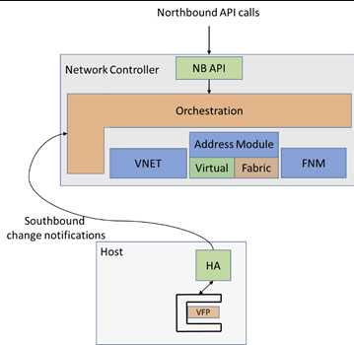
Network Controller services
NC is comprised of several services which are clustered through Service Fabric
NorthBound API (SDNAPI) provides an entry point for clients to communicate to NC

Slide 40
SDNAPI
The API service (SDNAPI.exe) is the service that provides the northbound entry point to the NC
Every REST or Powershell client will end up calling this service
Requests are rerouted to the appropriate NC service for handling
Notes:
Stateful Service. Exposes a northbound RESTful endpoint that can be used to monitor and configure resources. Requests are all processed through the SDNAPI and routed to the appropriate service.

Slide 41
Virtual Switch Manager (SDNVSM)
VNET Service Module and vSwitch Service Module operate under the VSM service
Leverages WCF for inter-service communication
OVSDB hardware_vtep schema is extended for HNV purposes, and this is called MS_VTEP
VNET will use OVSDB protocol and MS_VTEP schema to manage first party devices.
Notes:
Stateful Service. The VNET and vSwitch Service Modules operate under the VSM service. The VSM service performs all the vSwitch operations and functionality. It computes the policies and pushes them down to Hostagent which builds the corresponding VFP layers for carrying out all packet processing operations.

Slide 42
Firewall (SDNFW)
Controls and manages firewall rules (AccessControlLists)
Pushes rules down to the host, which will translate to VFP rules on the host
Applies ACL Policy to Virtual Network objects (Network Interface, Subnets)
Applies ACL Policy to Logical Network objects (Network Interface)
Notes:
Stateful Service. It controls and manages the firewall rules and configures the appropriate settings down to each of the Hyper-V hosts where the rules get programmed into VFP.

Slide 43
Service Insertion (SDNSI)
SI was initially developed to apply VFP Policy for Service Insertion (aka Service Chaining).
Azure then developed a feature called User Defined Routes and SDNSI was inconsistent. All other features were moved to other services to be consistent with Azure.
Port Mirroring is the only feature that still has dependency with Service Insertion
Notes:
Stateful Service.

Slide 44
Controller (SDNCTLR)
SLB Network Manager is hosted as part of the SDNCTLR service
Responsible for configuration of settings such as diagnostic logging on network elements
Provides service registry of services within NC and libraries for services to communicate with each other
Implements core framework of the network controller application
Notes:
Stateful Service. The SDN controller service implements the core framework of the network controller application. The framework provides a service registry of all the microservices of the network controller service fabric application, libraries for services to communicate with each other, a device and credential inventory, a southbound driver model to communicate to underlying fabric, and an address space manager library to help track allocation MAC and IP addresses.

Slide 45
Software Load Balancer Manager (SDNSLBM)
The SLB service (SDNSLBM.exe) is the service that manages the SLBs that are deployed in the NC environment.
SLBM receive goal state from the Load Balancer Engine (LBE) distribute it to all MUX instance’s over WCF
Connects to SLB Host Agent which resides on server (hypervisor) using SSL/TLS over TCP to push LB and NAT configurations
Notes:
Stateful Service. The SLB Manager is responsible for configurating VIP:DIP mappings on the LoadBalancerMuxes as well as pushing the configuration to the SlbHostAgent service on the Hyper-V hosts. SLB Manager will receive status updates for monitored DIP endpoints and update the LoadBalancerMuxes to remove DIPs from active load balancing configuration in scenarios where the DIP has been marked as down.

Slide 46
Gateway Manager (SDNGWM)
Handles deployment of the gateway pools
Pushes configuration of tenant connections on each gateway
Switches network traffic flows to standby gateway in event of gateway failure
Push goal state and configuration changes directly to RAS Gateway VMs, using WMI
Notes:
Stateful Service. Handles the deployment of the gateway pools and virtual gateways to the RAS gateways. Gateway manager will also communicate with Virtual Network service module (SDNVSM) to ensure routing is applied within VFP to route packets from workloads in/out of the corresponding RAS gateway that is hosting the Virtual Gateway connection.

Slide 47
Fabric Network Manager
Controls the logical network resources
Notes:
Stateful Service.

Slide 48
Helper Service
Updates credentials (certificates) on the servers.
Assists with upgrades for Service Fabric deployments of Network Controller.
Purges floating IP when SDNAPI is no longer on the primary node.
Updates HTTPs bindings.
Notes:
Stateless Service. Provides a variety of misc tasks for Network Controller.

Slide 49
Backup and restore
Automatically creates backups of Network Controller.
Orchestrates the restore of databases and other properties related to Service Fabric.
Notes:
Stateless Service. Handles creation of the backups for Network Controller as well as the restore when calling New-NetworkControllerRestore.

Slide 50
Update service
The update service monitors for new application packages under C:\Windows\NetworkController
When update package is detected, will initiate an update of the Service Fabric application if auto-updates are enabled (enabled by default)
NetworkController application packages are included as part of Windows Update
Notes:
Stateless Service. The update service is responsible for monitoring C:\Windows\NetworkController and initiating an update (Update-NetworkController) if new package is detected and auto-updates are enabled. Auto updates are enabled by default.
For Windows Servicing, the updated application packages are included in Windows Update within the c:\Windows\WinSxS directory and are copied into the C:\Windows\NetworkController folder during the update process if the Network Controller role is installed. At this point, the update service will call Update-NetworkController to initiate the update of the service fabric application. Customers should not update this application directly and instead should rely on Windows Updates to get newer versions of the applications. Updates to the application outside of this mechanism are not supported by Windows.

Slide 51
IN-Memory Object Store (IMOS)
Many of the services use In-Memory Object Store (IMOS)
Provides persisted, replicated state information for the service
IMOS provides database-like abstraction of the underlying WinFabric Key Value Store (KVS)
IMOS schema provides the deserialization
Every repository in IMOS has a schema that is described in an XML file
If data represented in IMOS does not match API, ensure you are working with engineering.
Notes:
Many of the Network Controller service modules use In-Memory Object Store (IMOS) for persisted, replicated state of the service. IMOS provides a database-like abstraction of the underlying Winfabric Key Value Store (KVS). This deserialization is achieved by describing an IMOS schema.
Every repository in IMOS has a schema that is described in an XML file with the .xmi extension. The .xmi file is processed by a tool to generate C# class definitions for the objects stored in the repository. The service module code uses the generated code as well as APIs exposed by the IMOS SDK to get/set the objects in the repositories. This implies that whenever the schema changes, the generated code changes and effectively the code package used by Winfabric gets updated. Every schema upgrade is also a Network Controller application upgrade and will follow the upgrade lifecycle.
Typically, when working with IMOS / KVS, you will want to be engaged with engineering to some capacity. Modification of data is complex and could cause extensive damage if done incorrectly.

Slide 52
Lab
Get the Service Fabric Service
Failover the Primary Replica
Get Process for Service Fabric Service
Examine IMOS data

Slide 53
Knowledge check - Services
What function does the Virtual Switch Manager (SDNVSM) serve?
What service exposes the Northbound API interface?
Notes:
See answers at end of the deck.

Slide 54
Describe Network Controller host agent

Slide 55
NC Host Agent
When adding servers to SDN infrastructure, NCHostAgent is installed as part of the NetworkVirtualization role
This enables Network Controller to manage goal state
NC services push configuration changes via OVSDB protocol to OVSDB
Notes:
During the onboarding of the Hyper-V hosts to SDN infrastructure, we install the Network Controller Host Agent to allow the Network Controller (NC) to manage the goal state of the data plane and to receive notifications of events as the configuration of the data plane changes.
Host Agent will receive instructions from the NC services (such as VSM, FWM, SLBM, and GWM) over the Open vSwitch Database (OVSDB) protocol. The NC Host Agent plug-ins will monitor OVSDB for any new goal state changes. Any changes in the data plane configuration and changes in goal state, will be sent as a notification event back to the Network Controller services.
The NC Services and the Event Coordinator receive notifications from the Host Agent. The Event Coordinator will send the notifications it receives in a pre-provisioned order to the NC Services. The Event Coordinator will be able to handle failures in the chain of notification events. The Host Agent and the Host Agent plug-ins maintain a stable goal state in the data plane.
All clients of the OVSDB Host Agent server need to authenticate to prevent any malicious client from sending unauthorized policy to the network elements. This is enabled using TLS and certificates over the client-server connection. The requirement is to ensure that clients are authenticated before they communicate with the OVSDB Host Agent server.

Slide 56
NC Host Agent
NCHostAgent plug-ins monitor OVSDB for goal state changes.
Plug-ins calculate the changes and program VFP via VFP API.
Any changes in dataplane regarding configuration or goal state, are sent as notification event back to Network Controller.
Event Coordinator on NC receives the notification event.
TLS is used for communication between southbound devices and Network Controller to prevent unauthorized policy configurations.
Notes:
Host Agent will receive instructions from the NC services (such as VSM, FWM, SLBM, and GWM) over the Open vSwitch Database (OVSDB) protocol. The NC Host Agent plug-ins will monitor OVSDB for any new goal state changes. Any changes in the data plane configuration and changes in goal state, will be sent as a notification event back to the Network Controller services.
The NC Services and the Event Coordinator receive notifications from the Host Agent. The Event Coordinator will send the notifications it receives in a pre-provisioned order to the NC Services. The Event Coordinator will be able to handle failures in the chain of notification events. The Host Agent and the Host Agent plug-ins maintain a stable goal state in the data plane.
All clients of the OVSDB Host Agent server need to authenticate to prevent any malicious client from sending unauthorized policy to the network elements. This is enabled using TLS and certificates over the client-server connection. The requirement is to ensure that clients are authenticated before they communicate with the OVSDB Host Agent server.

Slide 57
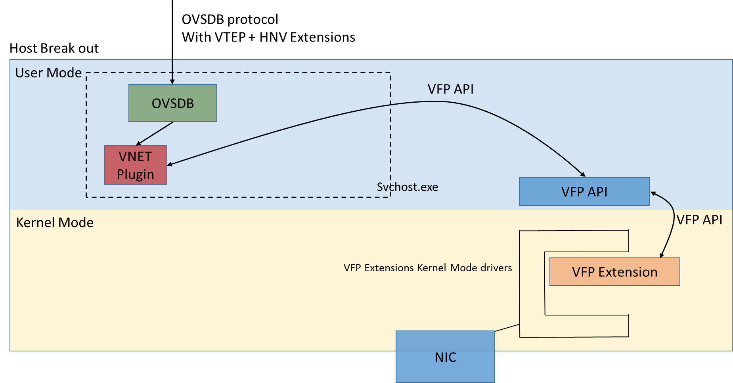
Network Controller Host agent framework
NC VNET Module (OVSDB Client) sends policy in OVSDB format to the Host Agent.
Host Agent OVSDB Server inserts the record into the appropriate OVSDB tables (MS_VTEP).
OVSDB Server via Host Agent sends response back to network controller (ACK).
Host Agent VNET plug-in receives the policy and sends the information to the VFP API.
The VFP API programs the flow rules into the virtual switch using the VFP extensions.
Notes:
In this diagram, we have a VNET policy push example.
Additional details:
The box with the dotted line is the host agent. It calls into the VFP switch extension which is separate component. That is the VFP API and VFP Extension on the right.
The VNET plugin and OVSDB are part of the same process which makes up the NC Host Agent. Communication between the components is via dll calls and internal callbacks. No need for timers as the notification to the VNET plugin takes place as soon as the write does.
If the NC Host Agent is down, then OVSDB won’t receive any updates

Slide 58
NC Host Agent OVSDB
OVSDB databases are stored under C:\ProgramData\Microsoft\Windows\NCHostAgent.
OVSDB-CLIENT.EXE can be used to interact with the databases.
OVSDB is listening on local port 6641.
Provider / Customer address mappings are stored in MS_VTEP.
ACLs are stored in MS_FIREWALL.
Notes:
The OVSDB tables are in C:\ProgramData\Microsoft\Windows\NcHostAgent folder
Ovsdb-client.exe can be used on the Hyper-V host to expose the configuration settings that the NCHostAgent has received from the Network Controller
You can expose the databases available by running ovsdb-client.exe list-dbs tcp:127.0.0.1:6641
Provider Address <-> Customer Address (PACA) mappings are stored in the ms_vtep database
ACLs are stored in the ms_firewall database

Slide 59
NC Host Agent OVSDB tables persistence
OVSDB tables are persisted in Host Agent across restarts
Allows datapath to continue working, in event where communication is lost between Host Agent and Network Controller
Provides cache at host agent, allowing for faster push of policies
Host Agent plug-ins can send full or differential goal state to Network Controller
Notes:
The OVSDB tables (policies) are persisted in the Host Agent across restarts.
There are several good reasons to pick persistence; the most important one is, if we do not keep the tables persisted, any changes in the network entities (operational/goal state) will be lost if there is a break in connectivity with the network controller, and the Host Agent is restarted prior to these changes being notified.
The ability to provide a cache at the Host Agent allows for a faster push of policy when network elements restart and request for policy. The trip back to the NC is obviated, instead policy from the OVSDB cache is immediately pushed.
The Host Agent plug-ins can send full state or send a “diff” of the goal state.
For sending the “diffs,” the NCHostAgent reads the current goal state of the networking endpoint and apply the diff based on the OVS tables or their internal cache.
The alternative is to send full state with each update, overwriting the entire policy.

Slide 60
NC and Host Agent goal state scenarios
OVSDB:Echo happen on periodic basis to assess liveness of connections between host agent and network controller
Both host agent and network controller send echo to determine others availability
When host agent comes up after crash, NC will send diff policy
When network controller goes down, any change to goal state of the network elements do not reach NC
Once host agent receives a monitor message, it knows that NC is available to receive notifications
The first OVSDB:Monitor request will ask for full tables, which ensures that any notifications that were lost when NC was down, are now reflected in NC
Notes:
Use of OVSDB: Echo on a periodic basis to assess ‘liveness’ of the connections between client and server.
Both the network controller (client) and the Host Agent OVSDB (server) will send Echo method to gauge if the far end is up.
When a Host Agent comes up after a crash, the network controller will send a diff policy set. There are two ways to detect that the Host agent is back up:
- The Host Agent sets up a TLS connection to the network controller.
- The Echo messages start getting responses.
When the network controller (or NC module) goes down, the most reliable way to detect it is the loss of Echo response. During this time, any change in goal state of the network elements does not reach the NC. Once the Host Agent receives a monitor message from the NC, it knows that the NC is ready to receive notifications. The first OVSDB: Monitor will ask for the full tables to be synced back to the network controller; this ensures that any notifications that were lost when the NC was down, are reflected to the NC.

Slide 61
OVSDB MS_VTEP
MS_VTEP is the main database within OVSDB.
MS_VTEP stores information related to ports, policies, etc.
NCHostAgent is responsible for updates to MS_VTEP.
Plugins within NCHostAgent monitor MS_VTEP for goal state changes.
Plugins are responsible for taking information from MS_VTEP and programming into VFP.
Notes:
MS_VTEP is the main database within OVSDB and has information about all the ports present on the hosts, policies to be applied, etc..
NCHostAgent updates MS_VTEP when a VM is added, removed, live migrated, etc..
NCHostAgent will notify Event Coordinator (EC) within SDN API on Network Controller
Event Coordinator (EC) will then notify other services about the change
Network Controller service receives a notification, it updates the MS_VTEP database on the respective host(s) with the policies to be plumbed.
Plug-ins within NCHostAgent are monitoring for any goal state policies and will read the update and plumb the appropriate policies into Virtual Filtering Platform (VFP).

Slide 62
Physical_Port table
Contains information about all the virtual machines and ports present on the host
On startup, NCHostAgent fetches information from Hyper-V via WMI and populates the table
NCHostAgent also receives VMSIF notification whenever a VM is added, updated, removed or live-migrated
Column | Description
Description | Corresponds to the VM port ID itself
Name | Corresponds to the profile ID of the VM
Status | Information about the VMs enumerated by NCHostAgent on the host

Slide 63
Physical_Switch table
Corresponds to the vSwitch present on the host
Column | Description
_UUID | Unique identifier.
Description | Not Used.
Distributed_Router_MAC | Correlates to the MAC address assigned to the DRhostVNic. Allocated from the macPools resources.
Management_Ips | Not Used.
Name | Will be a join of the Server HostID (InstanceID) and VMSwitch ID.
Other_Config | Not Used.
Ports | Aggregate of the ports associated with the switch. IDs will map to the _UUID of the Physical_Port table.
Tunnel_IPs | Not Used.

Slide 64
Ucast_Macs_Remote table
Populated by vSwitchService of Network Controller
NCHostAgent looks up information in this table using the MAC address and builds the policies to be pushed to the port
Column | Description
MAC | mac address of the port. HostAgent looks up this table using the MAC address and matches with the ports in Physical_Port_table
IPAddr | CA IP address to plumb
Locator | PA corresponding to the CA, points the Physical_Locator table.
Logical_Switch | Points to the Logical_Switch table.
Mapping_Type | type of mapping can be default, load_balanced, learning_disabled Default: default mapping Load_Balanced: Specifies load balanced mapping. This implies that the mapping is part of a load balancer. HostAgent configures transpose rules Learning_Disabled: A special mapping used for the CA VIP of the internal load balancer(ILB)

Slide 65
Physical_Locator table
Populated by vSwitchService within Network Controller
Contains a list of Provider Address (PA) to be used for Customer Address (CA)
Refers to the locator column within Ucast_Macs_Remote table
Column | Description
_UUID | Unique Identifier
BFD | Not Used
BFD_Status | Not Used
DST_IP | Provider Address
Encapsulation_Type | Outer encapsulation of packet used for VFP processing. VXLAN or NVGRE over IPv4/IPv6

Slide 66
Logical_Router table
This table translates to the Virtual Network Routing Domain ID (RDID)
There will be an entry for each Virtual Network within this table
A compartment is created for each entry in this table within the PAHostvNIC adapter
Column | Description
Name | Corresponds the instance id of the virtual network resource in networkcontroller. HostAgent will create a compartment corresponding to this and Get-NetCompartment will show a compartment with this Guid.
Other_Configs | Used to push metering, peering configuration etc.
Static_Routes | Additional static routes pushed internally. For example: on-premises routes pushed by gateway.
Switching_Binding | Has information about each subnet in the VNET. Guid here points the Logical_Switch table.

Slide 67
Logical_Switch table
Contains the virtual subnets.
Each entry will correspond to a virtual subnet
Column | Description
_UUID | Unique identifier, links to logical router table via switch_binding.
Encryption_Credential_Thumbprint | Encryption certificate used for secure vnet (WS 2019+)
Static_Routes | Static routes configured via UDR
Tunnel_Key | Corresponds to the Virtual Subnet ID (VSID) for the subnet.

Slide 68
OVSDB MS_Firewall
MS_Firewall database is used by the Firewall service to apply ACLs
Firewall plug-in within NCHostAgent monitors the goal state policies and will plumb appropriate policies within VFP

Slide 69
OVSDB ServiceInsertion
The database was originally developed to apply Service Chaining.
User Defined Routes was then created, which leverages VNET module (SDNVSM service) instead.
Only used to enable Port Mirroring functionality.
Notes:
See Use network virtual appliances on a virtual network | Microsoft Learn for more details on how to use Port Mirroring.

Slide 70
Lab
Verify Southbound Connectivity
Open vSwitch Database (OVSDB)

Slide 71
Knowledge check - Network Controller Host Agent
What are the three primary databases used by NCHostAgent?
Which database stores the information related to ports and policies?
How are policies programmed into VFP?
Notes:
See answers at end of the deck.

Slide 72
Perform diagnostic logging within Network Controller

Slide 73
Trace Logging
Logs are collected from the Network Controller and all the network elements managed by the Network Controller:
Servers
Software Load Balancers
Gateways
Logging is enabled as soon as new network element is added to SDN fabric.
Logs by default are stored locally on each machine
Diagnostic Logs: C:\Windows\Tracing\SdnDiagnostics
Network Controller Service Fabric Logs: C:\ProgramData\Microsoft\Service Fabric\log
Applies to Network Controller only.
Admins can alternatively configure a network share path to save the logs to, which all network elements will leverage.
Notes:
If a file location has not been specified, local logging will be used on each Network Controller node with logs saved under C:\Windows\tracing\SDNDiagnostics. These logs are saved using the following hierarchy:
CrashDumps
NCApplicationCrashDumps
NCApplicationLogs
PerfCounters
SDNDiagnostics
Traces
The Network Controller uses (Azure) Service Fabric. Service Fabric logs may be required when troubleshooting certain issues. These logs can be found on each Network Controller node at C:\ProgramData\Microsoft\Service Fabric.
Netsh Trace Scenarios and Manifest versus Non-Manifest Formats
The manifest file format is used more often now by development because the traces collected are able to be viewed immediately with Netmon 3.4 / Message Analyzer on the system. In other words, they can be decoded immediately by these tools with no user decode needed.
Non-Manifest file format is not readable until the user uses TMF/Symbols to decode the files. The customer must send these to us to decode because they contain confidential information about the protocols we use etc.

Slide 74
Trace logging
You can leverage Get-NetworkControllerDiagnostic to determine log location
Other information related to log limit, level, and days retention can also be observed
Configuration on network elements are stored in registry under HKEY_LOCAL_MACHINE\Software\Microsoft\NetworkController\SDN\Diagnostics
Scheduled tasks handle the logging and compression of the .etl into .cab format, in effort to reduce space needed
Leverages a username/password credential object to access devices to configure data collector and tasks
Task name | Description
SDN Diagnostics Task | Scheduled task that runs every 30 minutes to compress any .etl files within trace directory into .cab.
SDNDiagnosticsTrace | Creates a logman tracing session for the appropriate ETW providers based on the node role.

Slide 75
ETW logs
Manifest style ETW messages
ETW traces are binary and must be decoded to make it human readable
Need to be decoded by:
Netsh: For reliable decoding, needs to be decoded on the box where the trace was captured
Kusto: Ingestion process will automatically decode manifest based ETW logs

Slide 76
ETW providers (1/2)
Provider | GUID | Enabled
Microsoft-Windows-NetworkController-Deployment | 93E14AC2-289B-45B7-B654-DB51E293BF52 | Default
Microsoft-Windows-NetworkController-FirewallService | EA2E4E95-2B14-462D-BB78-DEE94170804F | Default
Microsoft-Windows-NetworkController-Framework | 80355850-C8ED-4336-ADE2-6595F9CA821D | Default
Microsoft-Windows-NetworkController-Framework | A1EA8728-5700-499E-8FDD-64954D8D3578 | Default
Microsoft-Windows-NetworkController-Framework | F1107188-2054-4758-8A89-8FE5C661590F | Default
Microsoft-Windows-NetworkController-GatewayManager | 8B0C6DD7-B6D8-48C2-B83E-AFCBBA5B57E8 | Default
Microsoft-Windows-NetworkController-Monitoring | D79293D5-78BA-4687-8CEF-4492F1E3ABF9 | Default
Microsoft-Windows-NetworkController-Monitoring-Alerts | F9FE05C6-ED15-4BCB-9F57-DF9D79211F53 | Default
Microsoft-Windows-NetworkController-OvsdbClients | 3916D60D-9C9C-5FE9-75F2-BD8D15E4ED36 | Default

Slide 77
ETW providers (2/2)
Provider | GUID | Enabled
Microsoft-Windows-NetworkController-SDNAPIEvents | A1EA8728-5700-499E-8FDD-64954D8D3578 | Default
Microsoft-Windows-NetworkController-SDNBREvents | BA100531-EB15-59AD-3763-7778E6B0920B | Default
Microsoft-Windows-NetworkController-Deployment | 93E14AC2-289B-45B7-B654-DB51E293BF52 | Default
Microsoft.Windows.NetworkController.SdnDiagnosticsTask | C7EE8AAB-3ED8-4EE8-9ACA-01F5441FE036 | Default
Microsoft-Windows-NetworkController-SDNDisc | 90399F0C-AE84-49AF-B46A-19079B77B6B8 | Default
Microsoft-Windows-NetworkController-SDNFNM | 77494040-1F07-499D-8553-03DB545C031C | Default
Microsoft-Windows-NetworkController-SDNHelper | F1107188-2054-4758-8A89-8FE5C661590F | Default
Microsoft-Windows-NetworkController-SDNSlbManager | D304A717-2718-4580-A155-458F8AC12091 | Default
Microsoft-Windows-NetworkController-ServiceInsertion | C755849B-CF02-4F21-B82B-D92D26A91069 | Default
Microsoft-Windows-NetworkController-Update | 516D1685-A69C-4018-911A-10F319644E9C | Default
Microsoft-Windows-NetworkController-VNetService | 999DFB0D-1667-4CB4-B3F2-15F3B067EFD6 | Default
Microsoft-Windows-NetworkController-VSwitchService | 5C8E3932-E6DF-403D-A3A3-EC6BF6D7977D | Default

Slide 78
Lab
Examine current diagnostic trace settings.
Examine Logman Trace Settings
Examine Scheduled Tasks
Convert and View and ETW Trace
Perform data collection using SdnDiagnostics module.

Slide 79
Knowledge check - Tracing
By default, where are logs stored for SDN fabric infrastructure nodes?
Which task is responsible for automatic compression and applying log retention policies?
Notes:
See answers at end of the deck.

Slide 80
Knowledge check answers (1/2)
Learning objective | Questions | Answers
1: Network Controller Architecture | What is the role of Windows Service Fabric in Network Controller? What are the two types of Services within Service Fabric? | Service Fabric plays a crucial role in the Network Controller by providing high availability, state replication, and quorum management. Stateful and Stateless Services
2. Northbound API | What type of authorization methods are available for securing the Northbound API? What type of data structure does the Northbound API use? | X509, Kerberos, None JSON
3. Southbound API | What authentication mechanism is used primarily to communicate with southbound devices? | X509 (Certificates)

Slide 81
Knowledge Check Answers (2/2)
Learning objective | Questions | Answers
4. Services | What function does the Virtual Switch Manager (SDNVSM) serve? What service exposes the Northbound API interface? | Hosts the vSwitch and vNet service modules that are used to program/manage the 1st party devices. ApiService
5: Network Controller Host Agent | What are the three primary databases used by NCHostAgent? Which database stores the information related to ports and policies? How are policies programmed into VFP? | MS_VTEP, MS_FIREWALL, ServiceInsertion MS_VTEP Plugins within NCHostAgent monitor OVSDB databases. When changes found, they calculate policy and push changes to VFP API.
6. Tracing | By default, where are logs stored for SDN fabric infrastructure nodes? Which task is responsible for automatic compression and applying log retention policies? | Locally on each node under c:\windows\tracing\sdndiagnostics. SDN Diagnostics Task

Slide 82
Summary
In this module, you learned about:
Network Controller architecture
Northbound API
Southbound API
Network Controller services
Network Controller Host Agent
Network Controller diagnostics

